Slide 1
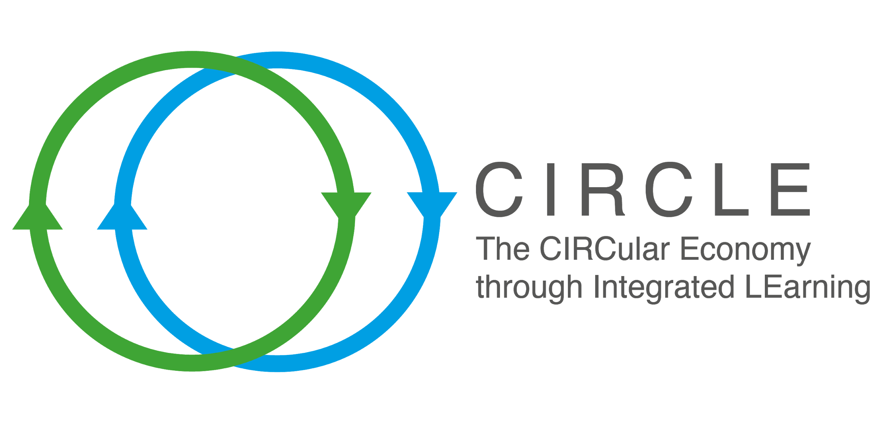



Avoiding food waste from the origin- Unit 12 A
.
Integrating the circular economy into vocational educational training for the agricultural sector
Notes:
Introductory slide

Slide 2
Overview
There are many causes of food waste or loss usually occuring throughout food processing systems, such as production, processing, distribution, retail, and consumption.
It is estimated that about 14% of raw food materials are lost after harvest. These raw food materials are not taken from farmers and do not reach retail. These raw materials are considered unfit for trade due to size, shape, commercial appearance, i.e. the raw food material is fit for consumption, but its visual properties are not acceptable to supermarkets.
The United States Environmental protection agency estimated that in 2018 42.8 million tonnes of food ended up in landfills or incinerators.
Food waste is linked to globalization. Through supply chains, food is delivered to the market.
Notes:
Slide for bulleted list

Slide 3

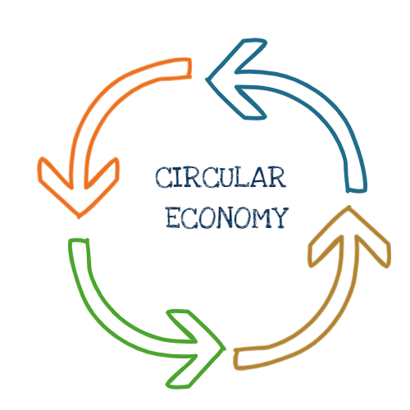
Unit Learning Objectives
Knowledge | To understand the causes of food waste and avoid food waste through logistics supply chains that reduce environmental impact and promote the benefits of circular economy.
Skills | To identify the causes and elements of food wastage through supply chains during supply.
Competencies | To be able to apply the principles of circular economy in the provision of supply chain management services.
EQF Level | This content is mainly suitable for EQF level 4.
Notes:
Alternative slide to the bulleted list slide

Slide 4
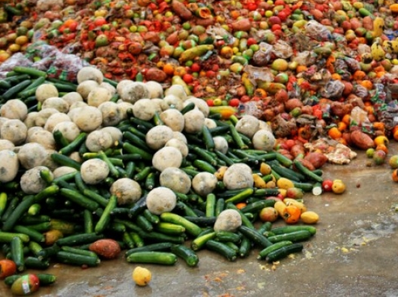
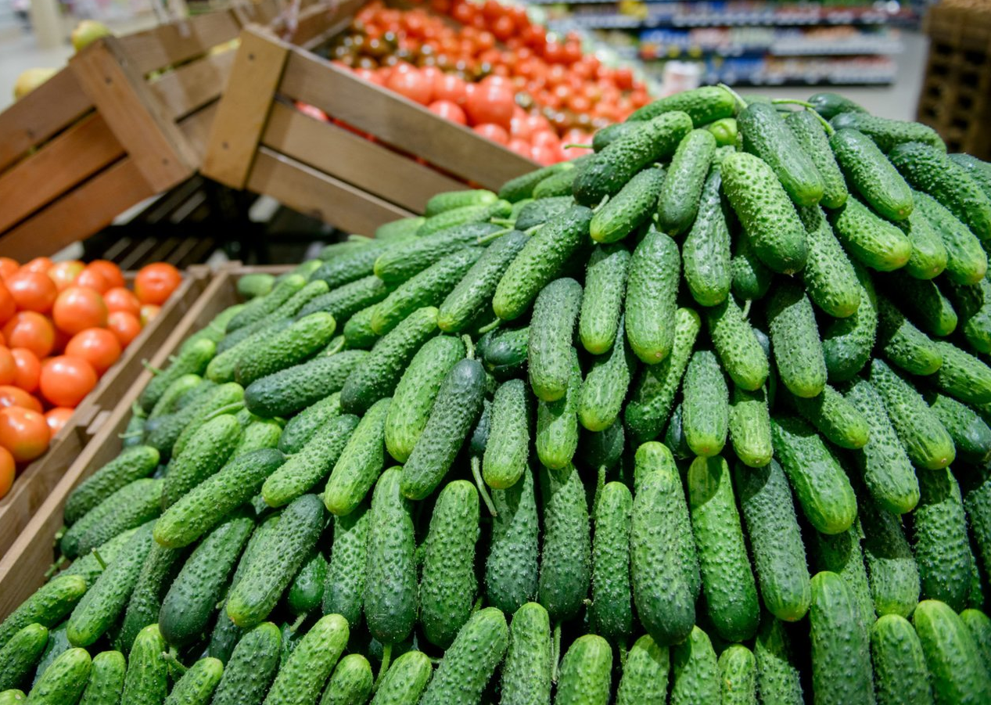
Over-production (surplus)
Overproduction is the accumulation of unsold inventories in the hands of businesses.
It is referring to the excess of production over consumption.
In the context of inventories, a surplus describes products that remain sitting on store shelves, unpurchased.
Long supply chains, which can offer exotic foods to markets from distant countries or other continents, can lead to an oversupply of products, resulting in surplus.
Notes:
Alternative slide to the bulleted list slide

Slide 5
Situations that generate food waste and food losses along the food supply chain
Fish discards; Loss of milk due to bacteria; Crops not fully harvested or green – harvested; Product damage during harvest, storage or transport; Products sorted out due to cosmetic requirements; Unpredictable changes of contract terms
Production
Process losses (peeling, washing, slicing, boiling, etc.); Wastes from plant shut – down / washings, spillage, spoilage; Product damage during storage; Suppliers having to take back products that were not sold
Processing
Date expiry in depot / in – store; Product not sold despite „mark – downs“; Surplus stock; Product damage or quality / weight reduction during storage; Products sorted out due to cosmetic requirements
Retail
Waste during storage; Surplus cooked; Food that has been „spoilt“; Food preparation waste; Plate scrapings
Consumers
Notes:
Alternative slide to the bulleted list slide

Slide 6
Redistribution of surplus produce
WRAP organised a program in the UK in 2015 when about 660,000 tonnes of food that had to become waste were diverted to the production of animal feed and used as raw materials from which animal food was produced.
WRAP also took on initiative in the UK 2018 when about 700,000 tons of food with a short shelf life were redistributed to charities that distributed food to the less fortunate.
WRAP works with food retailers, manufacturers, hospitality and food service businesses and redistribution organisations, together with industry bodies, to identify ways of increasing the beneficial use of surplus food, by working to remove barriers to surplus food redistribution.
Reference: https://wrap.org.uk/resources/report/surplus-food-redistribution-uk-2015-2020 (In English)
Notes:
Alternative slide to the bulleted list slide

Slide 7
Production lost due to weather, pests and dumping: how to diminish the loss
Modern technologies that help farmers regulate their production are as follows:
Water wells interrupt excess water from crop fields;
During drought, crop fields are irrigated with collected water from drained fields;
Crop rotation takes place to prevent plant diseases from taking root in crop fields;
Proper soil preparation;
Different plants are planted next to each other helping to combat diseases e.g. strawberries and garlic, as a result strawberries are healthy and are not attacked by mites;
Products that are grown in accordance with the rules of agrotechnics are healthier, higher quality and more acceptable to buyers.
Notes:
Alternative slide to the bulleted list slide

Slide 8
EU Farm to Fork strategy
The Farm to Fork Strategy aims to accelerate our transition to a sustainable food system that should:
        Have a neutral or positive environmental impact;
  Help to mitigate climate change and adapt to its impacts;
  Reverse the loss of biodiversity;
  Ensure food security, nutrition and public health, making sure that everyone has access to sufficient, safe, nutritious, sustainable food;
  Preserve affordability of food while generating fairer economic returns, fostering competitiveness of the EU supply sector and promoting fair trade.
Sustainable food
production
Farm to fork
Sustainable food processing and distribution
Food loss, waste prevention
Sustainable food processing, distribution
Sustainable food consumption
Reference: https://ec.europa.eu/food/horizontal-topics/farm-fork-strategy_lt ( EU languages)
Notes:
Alternative slide to the bulleted list slide

Slide 9
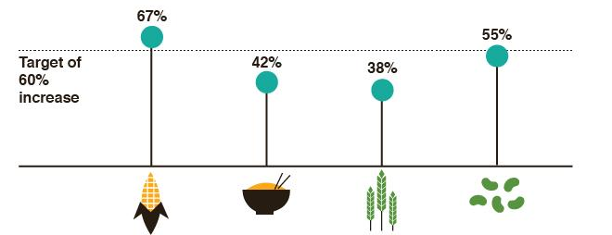
Demand-based production
Demand-based production enables a synchronized, closed loop between customer orders, production scheduling, and manufacturing execution - all while simultaneously coordinating the flow of materials and resources across the supply chain.
It is based on actual orders rather than forecasts.
Global competition and rapid product development make it increasingly easier to supply a variety of foods through more flexible supply chains. It is becoming increasingly difficult for traders to predict which products will be sold and to plan production accordingly.
Uncontrolled consumption makes it difficult to make accurate to forecast sales, as a result of which food is not sold, thrown away, waste takes up space in the warehouse, and other products cannot be supplied, and sometimes costs exceed production costs.
Fields of maize, rice wheat, and soybean all need to INCREASE by 60%, by 2025 to meet demand but current numbers are falling short
Target of 60% increase
Notes:
Alternative slide to the bulleted list slide

Slide 10
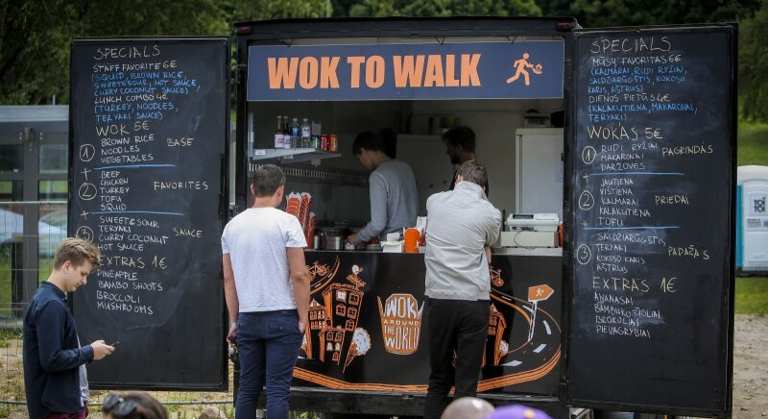
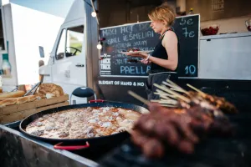
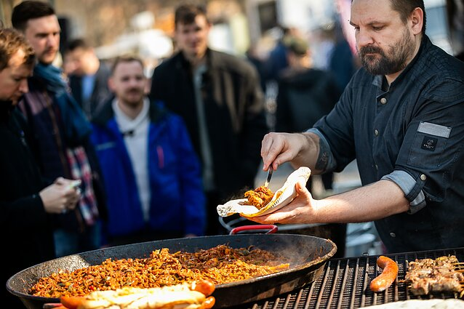
Combining local and seasonal food production
Local food is fresher and more nutritious, especially considering that most of the vitamins and minerals contained in fruits and vegetables are normally lost within 24 hours after being picked.
Fruit and vegetables with the lowest GHG emissions are those grown outside during their natural season without much use of additional energy and consumed in the same country of origin.
Food grown by local communities promotes domestic consumption within the community.
OPEN KITCHEN is offered by the community, which promotes entrepreneurship, community spirit, the development of circular economy in the region and popular gastronomy.
Notes:
Alternative slide to the bulleted list slide

Slide 11
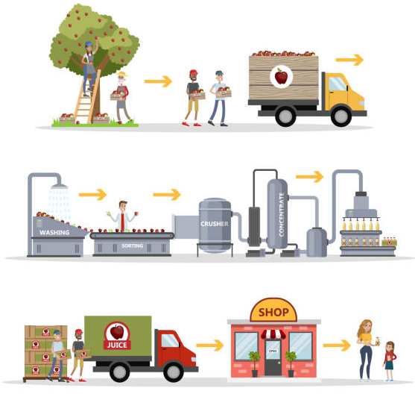
Discussion Points
Topic - importance and benefits of local farming/production in terms of the whole supply chain.
How does buying locally grown food, can help sustain local economy?
Are there social and community benefits of buying local food?
Do you know any examples of where and how you can buy local food?
Choose one subtopic and discuss it in a group.
Notes:
Alternative slide to the bulleted list slide

Slide 12
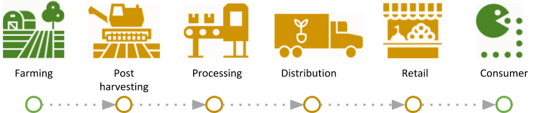
Avoiding high-mile farm food: producing local
By reducing “food miles“—how far your food must be transported—you can reduce environmental damage.
Fossil fuels are burned over the long distances that food often travels, releasing the carbon dioxide, sulfur dioxide, particulate matter, and other pollutants that contribute to global climate change, acid rain, smog, and local air pollution.
Local farmers supply food to local caterers, institutions therefore needing more staff. Workers can buy services and goods from local entrepreneurs. Cash flows occur in one region.
In the interests of sustainable farming and nature conservation, food production should be based on food grown in the region, as this reduces traffic and supports local business.
Farming
Post harvesting
Processing
Distribution
Retail
Consumer
Notes:
Alternative slide to the bulleted list slide

Slide 13
Functions in agrofood chains
General representation
FARMER
First processing
Intermediation and transportation
Processing
Storage
Intermediation and transportation
Distribution
Consumer
Farmers market model
FARMER
First processing
Intermediation and transportation
Processing
Storage
Intermediation and transportation
Distribution
Consumer
Pick-your-own model
FARMER
First processing
Intermediation and transportation
Processing
Storage
Intermediation and transportation
Distribution
Consumer
Notes:
Alternative slide to the bulleted list slide

Slide 14
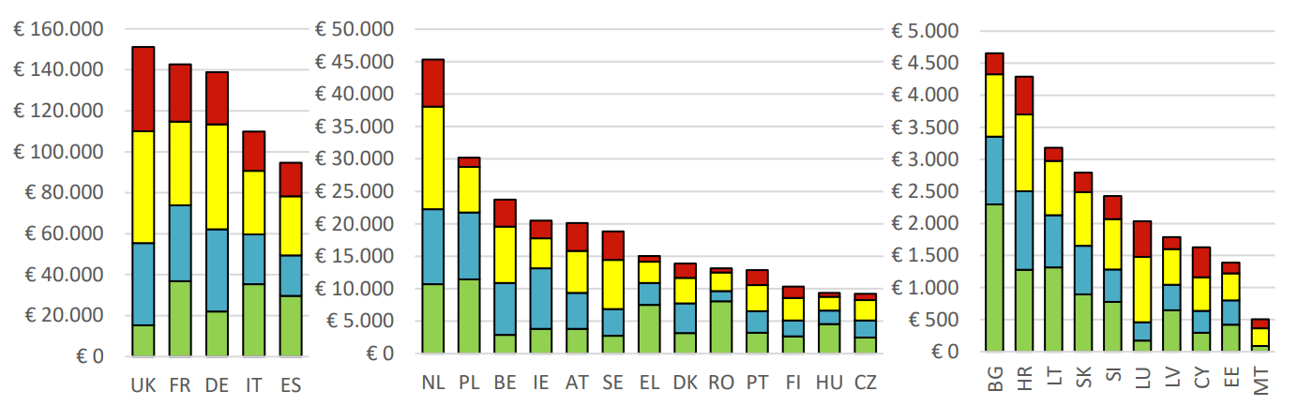
Value added in the food chain in million EUR – EU Member States
mln. EUR
mln. EUR
mln. EUR
EU member
EU member
EU member
Food and baverage consumer services
Food and baverage manufactering
Food and baverage distribution
Primary producers
Notes:
Alternative slide to the bulleted list slide

Slide 15
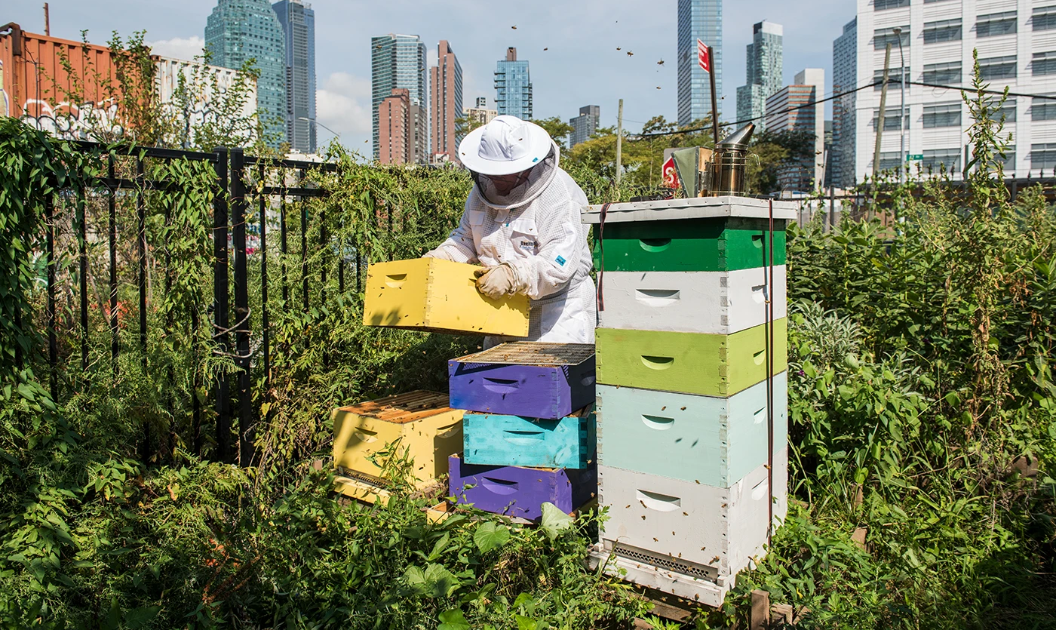
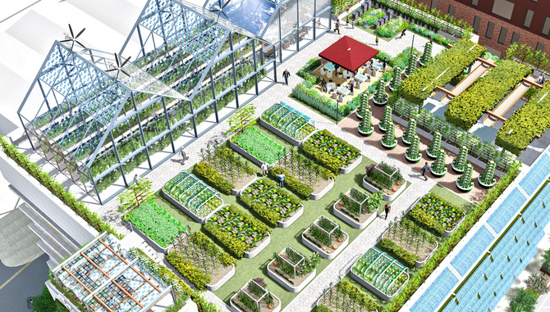
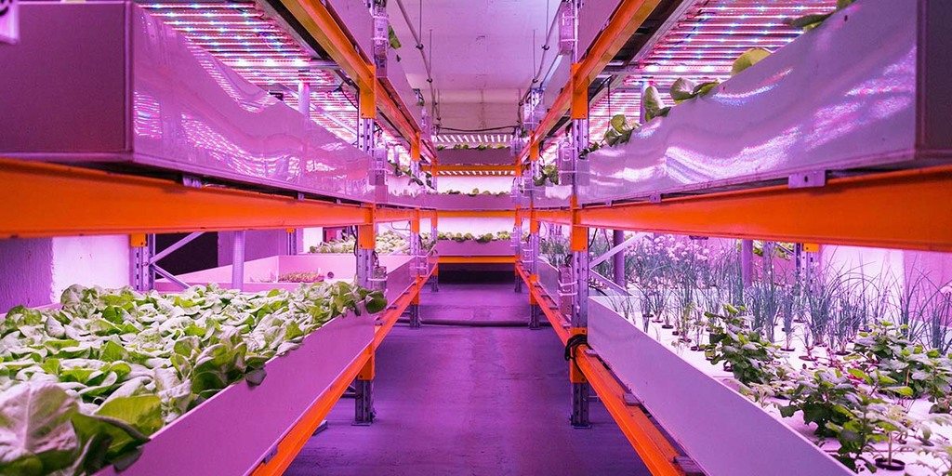
Urban Farming
Urban farming is the practice of cultivating, processing, and distributing food in or around urban areas.
Urban agriculture has become a means to increase access to locally grown food and a way of reintroducing the public to the many aspects of food.
Urban farming is not necessarily associated with big businesses.
Using aquaponic or hydroponic systems, food is grown on roofs in small areas from which food is supplied to local restaurants and other traders.
It encourages the creation of new businesses, uses rainwater for watering crops, supplies seasonal food, and involves community participation.
Notes:
Alternative slide to the bulleted list slide

Slide 16
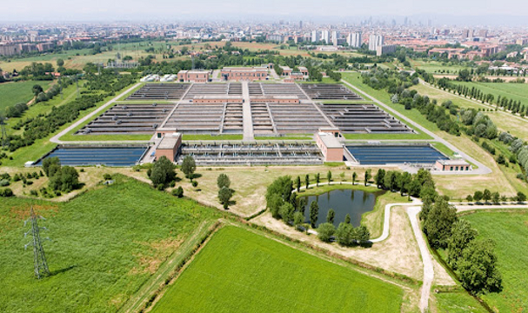
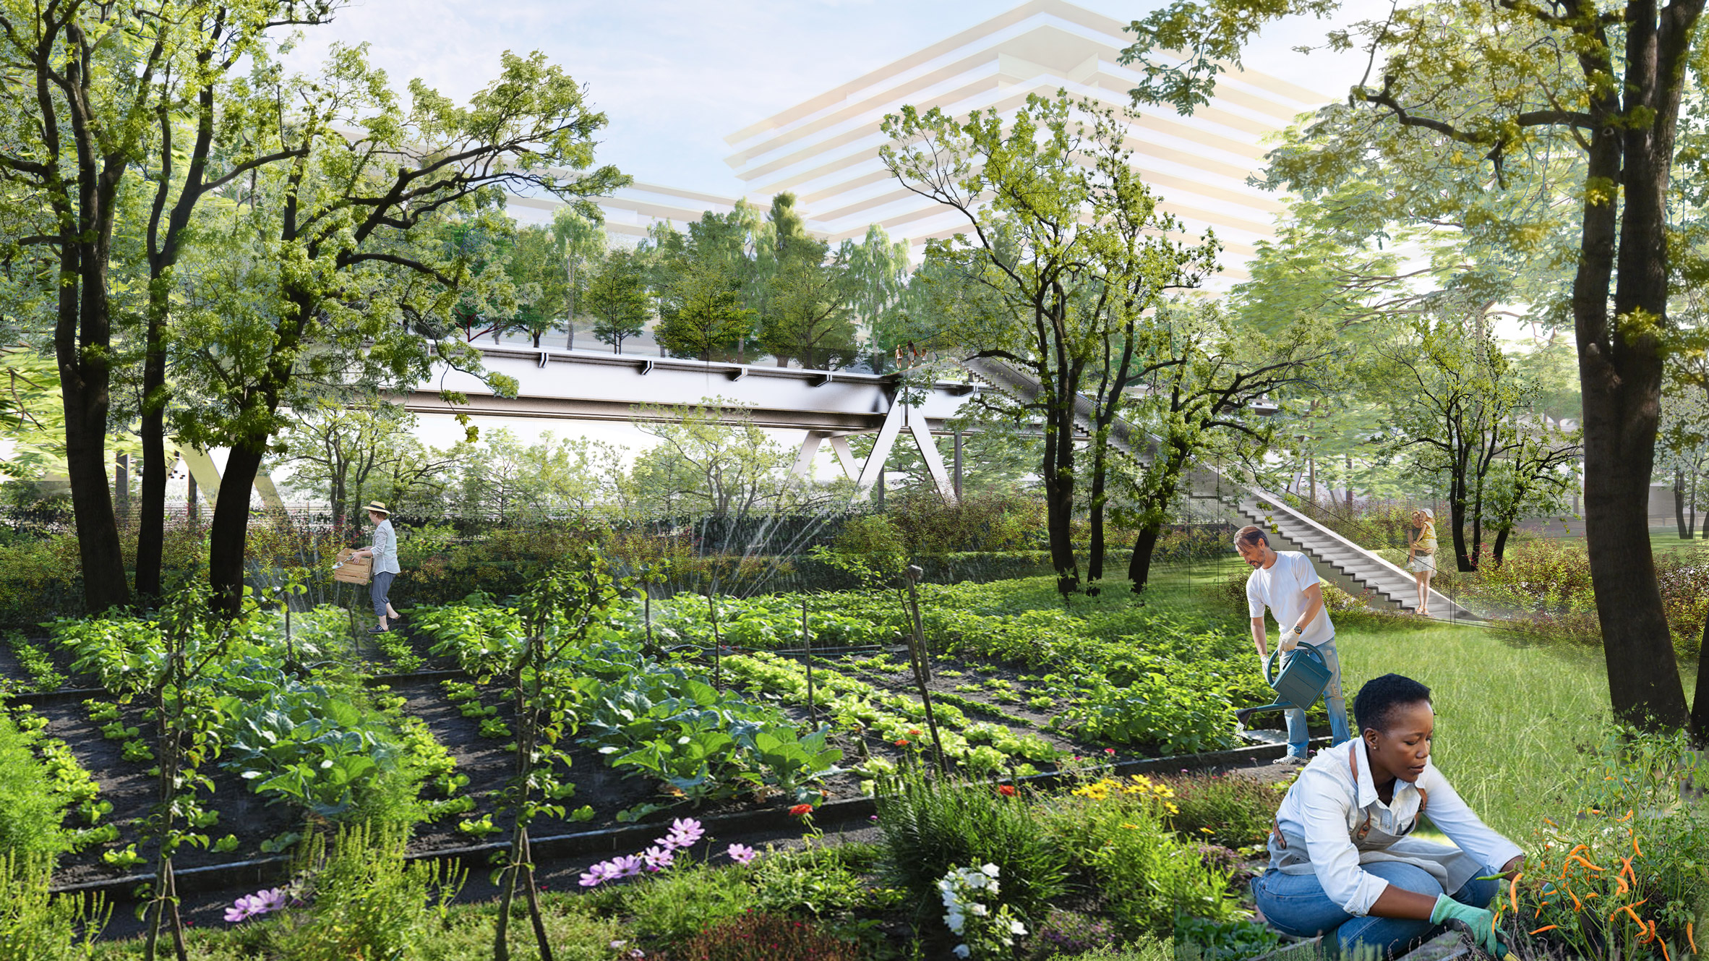
Case Study - urban agricultural parks
These are the kind of parks that make up agriculture. These parks not only protect the soil, but also produce food, promote “Km 0”, which is available to suburban residents.
Encourages community and stakeholder involvement in maintaining the security of the local food system.
Urban agricultural activities benefit the urban population: health, social, economic and environmental.
Parks are committed to protect the soil, preserve the landscape, promote ecological balance of the great, shortening supply chains, protecting food and the environment.
Notes:
Alternative slide to the bulleted list slide

Slide 17
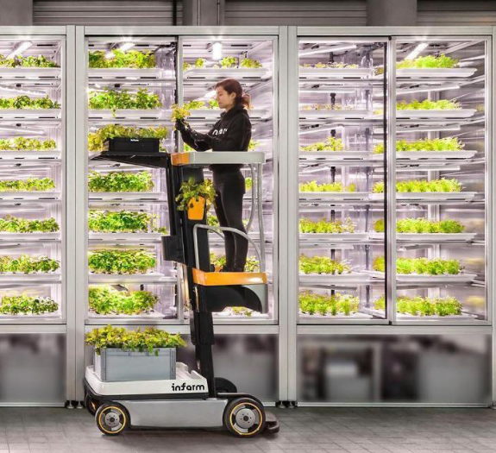
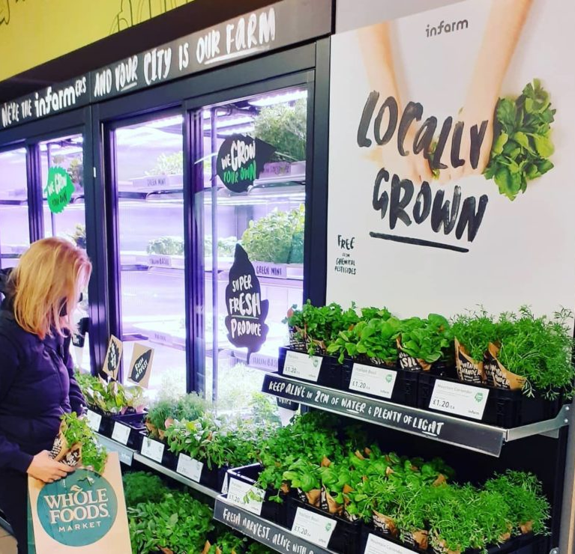
Case Study - InFarm
Vertical farming targets growing food using a fraction of land and water needed in conventional agriculture, without needing pesticides.
Growing crops on vertically stacked shelves in cities has gained particular attention during the pandemic amid concerns about food security, safety and local self-reliance.
Indoor farming startup INFARM raised an additional €100 million to expand into more foods as the coronavirus pandemic increases interest in growing produce in urban areas.
INFARM grows the products as needed for the market, the production of the products is controlled and supervised, so no food is wasted, 95% of the water is used compared to the crop, the production of the products under controlled conditions reduces the CO2 emissions by 90%.
Notes:
Alternative slide to the bulleted list slide

Slide 18
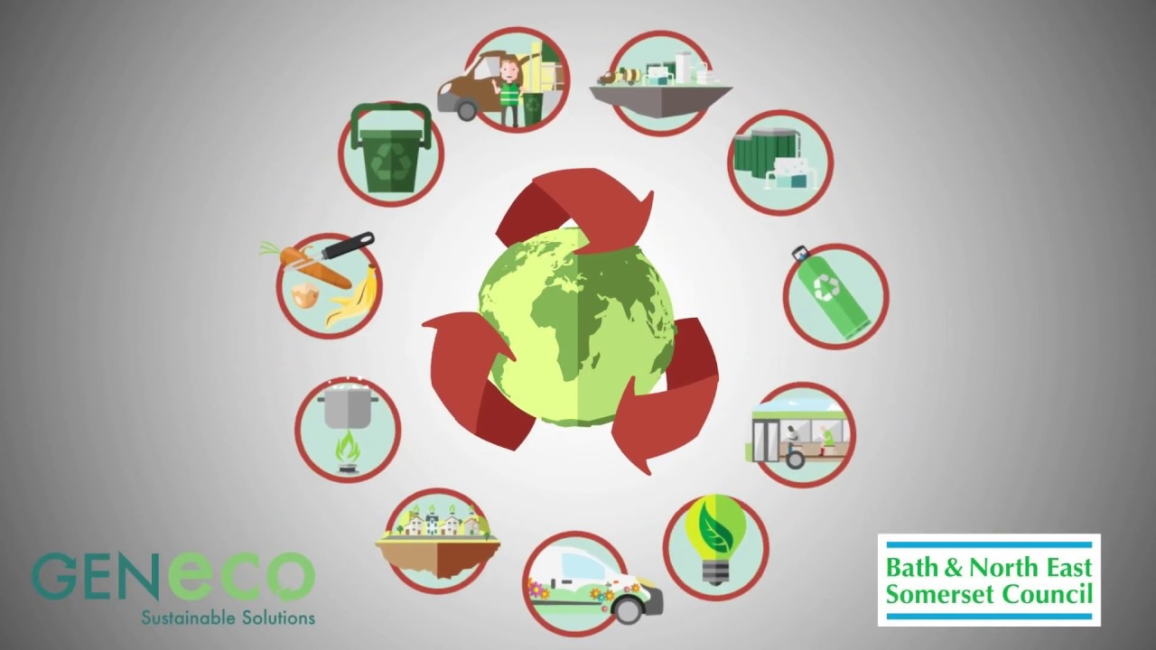
Discussion Points
Topic - European consumers place a higher value on food purchased in local markets, which in turn has a positive impact on consumer wastage. How to boost it?
How can local agriculture or farming contribute to local produce?
What EU measures can have an impact on the fight against food waste?
Choose one subtopic and discuss it in a group
Notes:
Alternative slide to the bulleted list slide

Slide 19
Discussion Points
Topic - Producing local, what at what price? Environmental and economic barriers for local production of foreign products.
Why is a local product more expensive than an imported product?
What do you think are the reasons that strongly determine the price of a product, such as: wages, technical base, seeds, etc.
Choose one subtopic and discuss it in a group
Notes:
Alternative slide to the bulleted list slide

Slide 20
Summary
Food waste can be managed by economic principles like proper management, supply chain management, customer understanding and cognition.
Farming and gathering local food promotes circular economy, involves the whole community, creates new jobs, consumes and buys services in their region, promotes a healthy lifestyle and protects local gastronomy.
New food production technologies are more environmentally friendly and reduce the resources used for food production. The INFARM example shows that controlling growing conditions can reduce CO₂ production by up to 90% and water consumption by less than 95%.
Urban farming allows the use of small areas and spaces for food production on the roofs of buildings, basements, other small spaces that are suitable for food production.
Local food producers are shortening supply chains and reducing road congestion.
Notes:
Alternative slide to the bulleted list slide

Slide 21
You have learned:
Knowledge | The knowledge gained will help to understand the causes of food waste and avoid food waste through logistics supply chains that reduce environmental impact and promote the benefits of the circular economy.
Skills | The skills acquired or improved will help to identify the causes and elements of food wastage through supply chains during supply and to adapt circular economy techniques to logistics and agricultural sector participants.
Competencies | The acquired competencies will help to apply the principles of the circular economy in companies providing logistics and agricultural services.
Notes:
Alternative slide to the bulleted list slide

Slide 22
Quiz
1. How can we prevent food wasting?
We should buy more fast-food, we don't have to prepare it at home.
We shouldn't throw away food that can be reused.
We should eat in restaurants, so not to throw away food at home.
Notes:
Alternative slide to the bulleted list slide

Slide 23
Quiz
1. How can we prevent food wasting?
We should buy more fast-food, we don't have to prepare it at home.
We shouldn't throw away food that can be reused.
We should eat in restaurants, so not to throw away food at home.
Notes:
Alternative slide to the bulleted list slide

Slide 24
Quiz
2. Who should care about food waste?
Only mothers because they cook dinners.
Only fathers because they go shopping.
Everyone should be aware of food wasting because it's our common responsibility.
Notes:
Alternative slide to the bulleted list slide

Slide 25
Quiz
2. Who should care about food waste?
Only mothers because they cook dinners.
Only fathers because they go shopping.
Everyone should be aware of food wasting because it's our common responsibility.
Notes:
Alternative slide to the bulleted list slide

Slide 26
Quiz
3. Why is some produce thrown away?
It's the wrong shape;
It's too expensive;
Farmers need fertilizer.
Notes:
Alternative slide to the bulleted list slide

Slide 27
Quiz
3. Why is some produce thrown away?
It's the wrong shape;
It's too expensive;
Farmers need fertilizer.
Notes:
Alternative slide to the bulleted list slide

